Slide 1
Vocabulary Strategies for Grade K 8
Student’s Name
Institutional Affiliation

Slide 2
Introduction
The self-gathering vocabulary methodology helps the learners pick the words they want to learn.
According to O'Connor et al. (2013), the self-gathering vocabulary methodology is a viable way to deal with the students to understand the implications of new words.
Substance range perusing tends to appreciate the use of the self-gathering vocabulary methodology.
Notes:
Learning new vocabularies forms the educational success of any learner, thus, the educators should chose the best methodology. The self-gathering vocabulary methodology helps the learners pick the words they want to learn. It has been proven that when learners pick the words they want they are able to understand the concept even better. In addition, according to O'Connor et al. (2013), the self-gathering vocabulary methodology is a viable way to deal with the students to understand the implications of new words. Furthermore, substance range perusing tends to appreciate the use of the self-gathering vocabulary methodology. Hence, the educators should highly emphasize use of self-gathering vocabulary methodology in their teaching profession to enable the students to learn new vocabularies.

Slide 3
Key Vocabularies to Pre-teach Students
The first vocabulary to pre-teach the students is the amendment.
The second vocabulary to pre-tech the students is violate.
Amendment and violate are the two main vocabularies in the passage ‘News debate: Religion on display’ thus forming the context of the passage.
Notes:
Amendment and violate are the two main vocabularies to pre-teach from the passage ‘News debate: Religion on display’. The two vocabularies forms the context of the passage as they are used in various sentences. Pre-teaching the students about the vocabularies will help them to understand more about the context.

Slide 4
Strategy for Pre-teaching Vocabulary
The best strategy to help learners read new vocabulary is to peruse knowledge as part of the preceding content (Cheung & Slavin, 2013).
All teachers should not tell the students what the word implies but convey the importance of the word to them.
By the educator not telling the learners what the word implies enables them to search for their meaning and also have a clear understanding of the word.
Notes:
Different scholars have had argument on the best strategy to pre-teach vocabulary. However, the best strategy to help learners read new vocabulary is to peruse knowledge as part of the preceding content (Cheung & Slavin, 2013). Perusing knowledge strategy is very important as it will enable the learners to have a hint of what they are going to learn. For that reason, all teachers should not tell the students what the word implies but convey the importance of the word to them. This has been proven to be helpful over the years. On the other hand, by the educator not telling the learners what the word implies enables them to search for their meaning and also have a clear understanding of the word. This equips the learners with the motivation to have the eager to learn more new vocabularies.

Slide 5
Strategy in Post Teaching Vocabulary
The most efficient strategy to post teach vocabulary is supplanting the difficult words with similar simpler words to enable the learner understand the general content.
Supplanting the difficult words with the simpler words helps the learners to improve their vocabularies.
The educator may also include some reference words on the board so that the learners can look up to them when reading the content. (Blachowicz et al., 2013).
Notes:
Although there exist many strategies to post teach vocabulary, the most efficient strategy to post teach vocabulary is supplanting the difficult words with similar simpler words to enable the learner understand the general content. This is a strategy that has been appraised by many scholars across the globe. The reason behind the great support of the strategy is because supplanting the difficult words with the simpler words helps the learners to improve their vocabularies. On the other hand, the educator may also include some reference words on the board so that the learners can look up to them when reading the content. (Blachowicz et al., 2013). This will boost the learner’s comprehension of the content being taught in class.

Slide 6
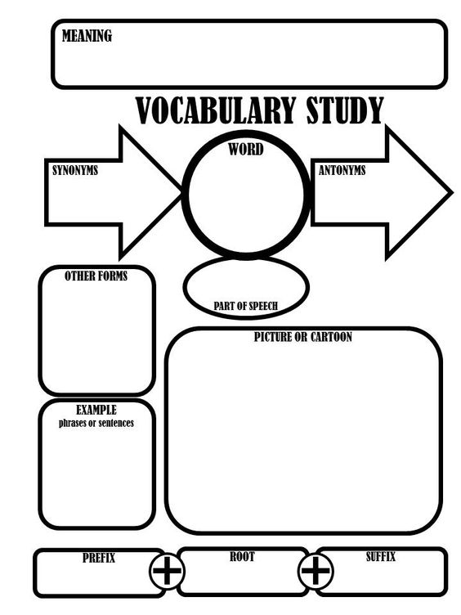
Thematic Graphic Elements
Notes:
Image for thematic graphic elements in teaching vocabulary (2017).

Slide 7
References
Blachowicz, C., Ogle, D., Fisher, P., & Taffe, S. W. (2013). Teaching academic vocabulary K-8: Effective practices across the curriculum. Guilford Press.
Cheung, A. C., & Slavin, R. E. (2013). Effects of educational technology applications on reading outcomes for struggling readers: a best‐evidence synthesis. Reading Research Quarterly, 48(3), 277-299.
Image for thematic graphic elements in teaching vocabulary. (2017). Retrieved from https://www.google.com/url?sa=i&rct=j&q=&esrc=s&source=images&cd=&cad=rja&uact=8&ved=0ahUKEwjX8- W7wIvXAhWK1BoKHTaqC98QjRwIBw&url=https%3A%2F%2Fwww.pinterest.com%2Fpin%2F5570390476315541 36%2F&psig=AOvVaw3-MFEFWkVDYDM63kcjNlNt&ust=1509011505980656 on 25th October 2017.
O'Connor, R. E., Bocian, K. M., Beach, K. D., Sanchez, V., & Flynn, L. J. (2013). Special education in a 4‐year response to intervention (rti) environment: characteristics of students with learning disability and grade of identification. Learning Disabilities Research & Practice, 28(3), 98-112.

